Slide 1






How do computers
Work?
A Journey into the heart of Computing
Notes:
Good afternoon, everyone! Have you ever wondered what happens inside a computer when you type a letter on our keyboard? How does it work? This question has taken me to a fascinating adventure of learning and building a computer from the ground up. But before we dive into the details of the research, let us discover how I decided to complete this project without taking single course in computer engineering.

Slide 2



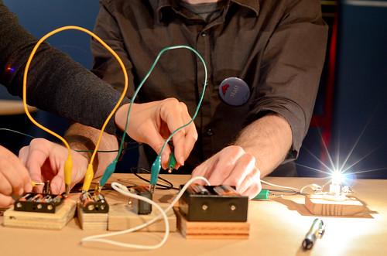


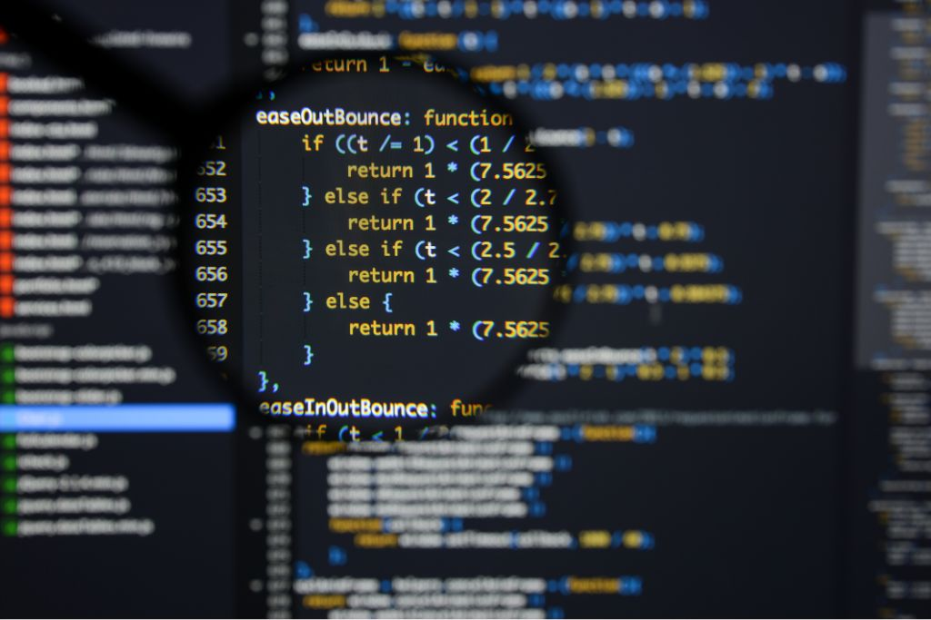

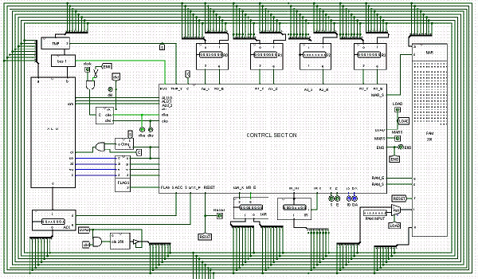
A light bulb
Tinkering
My number one habit! Deciphering and building electronic circuits, trying to understand the use case of each component
Programming
In 3 months, I taught myself how to code in java. Since then, I explored other programming languages such as Python, C++, XML, HTML, etc.
Logic Gates
Curious about how programs are executed, I watching videos about how computers work. The videos were created and uploaded by Ben Eater, where he explains the core design of computer.
Notes:
I am from Burkina Faso, a country in Africa where electricity is a scarce resource. When I was a kid, we did not have it in our house. At the age of 6, the first time I saw a lightbulb was still engraved on my head. I was amazed and astonished. I started asking myself if this was magic or some sort of witchcraft maneuver. This encounter alone has triggered my curiosity for electronics. Since then, I collected broken toys from rich families to tinker with. And that is how II learned about how electronic components work. And I still do it up to date. Not do I learn a lot, but tinkering brings me so much joy it became an addiction for me.
But as I was learning about more components, I stumbled on some (microchips) that I could not tinker with. It took me years before knowing that those components were programmable. So, I started reading pdf about how to code in java, and I mastered the basics of this programming language in 3 months. It even helped me to skip a computer science class. But that is the end of the story.
I started wondering how the computer knows what the code is telling it to do. Most programming languages use human language to instruct the computer to do something. And it started my journey to learning about how computers work. In Burkina Faso, I did not have any resource to complete such a big project. The only thing I could do was to intensify my research about computers by watching the same YouTube videos over and over. So being at Madison College is what actually allowed me to pursue this quest of knowledge.

Slide 3


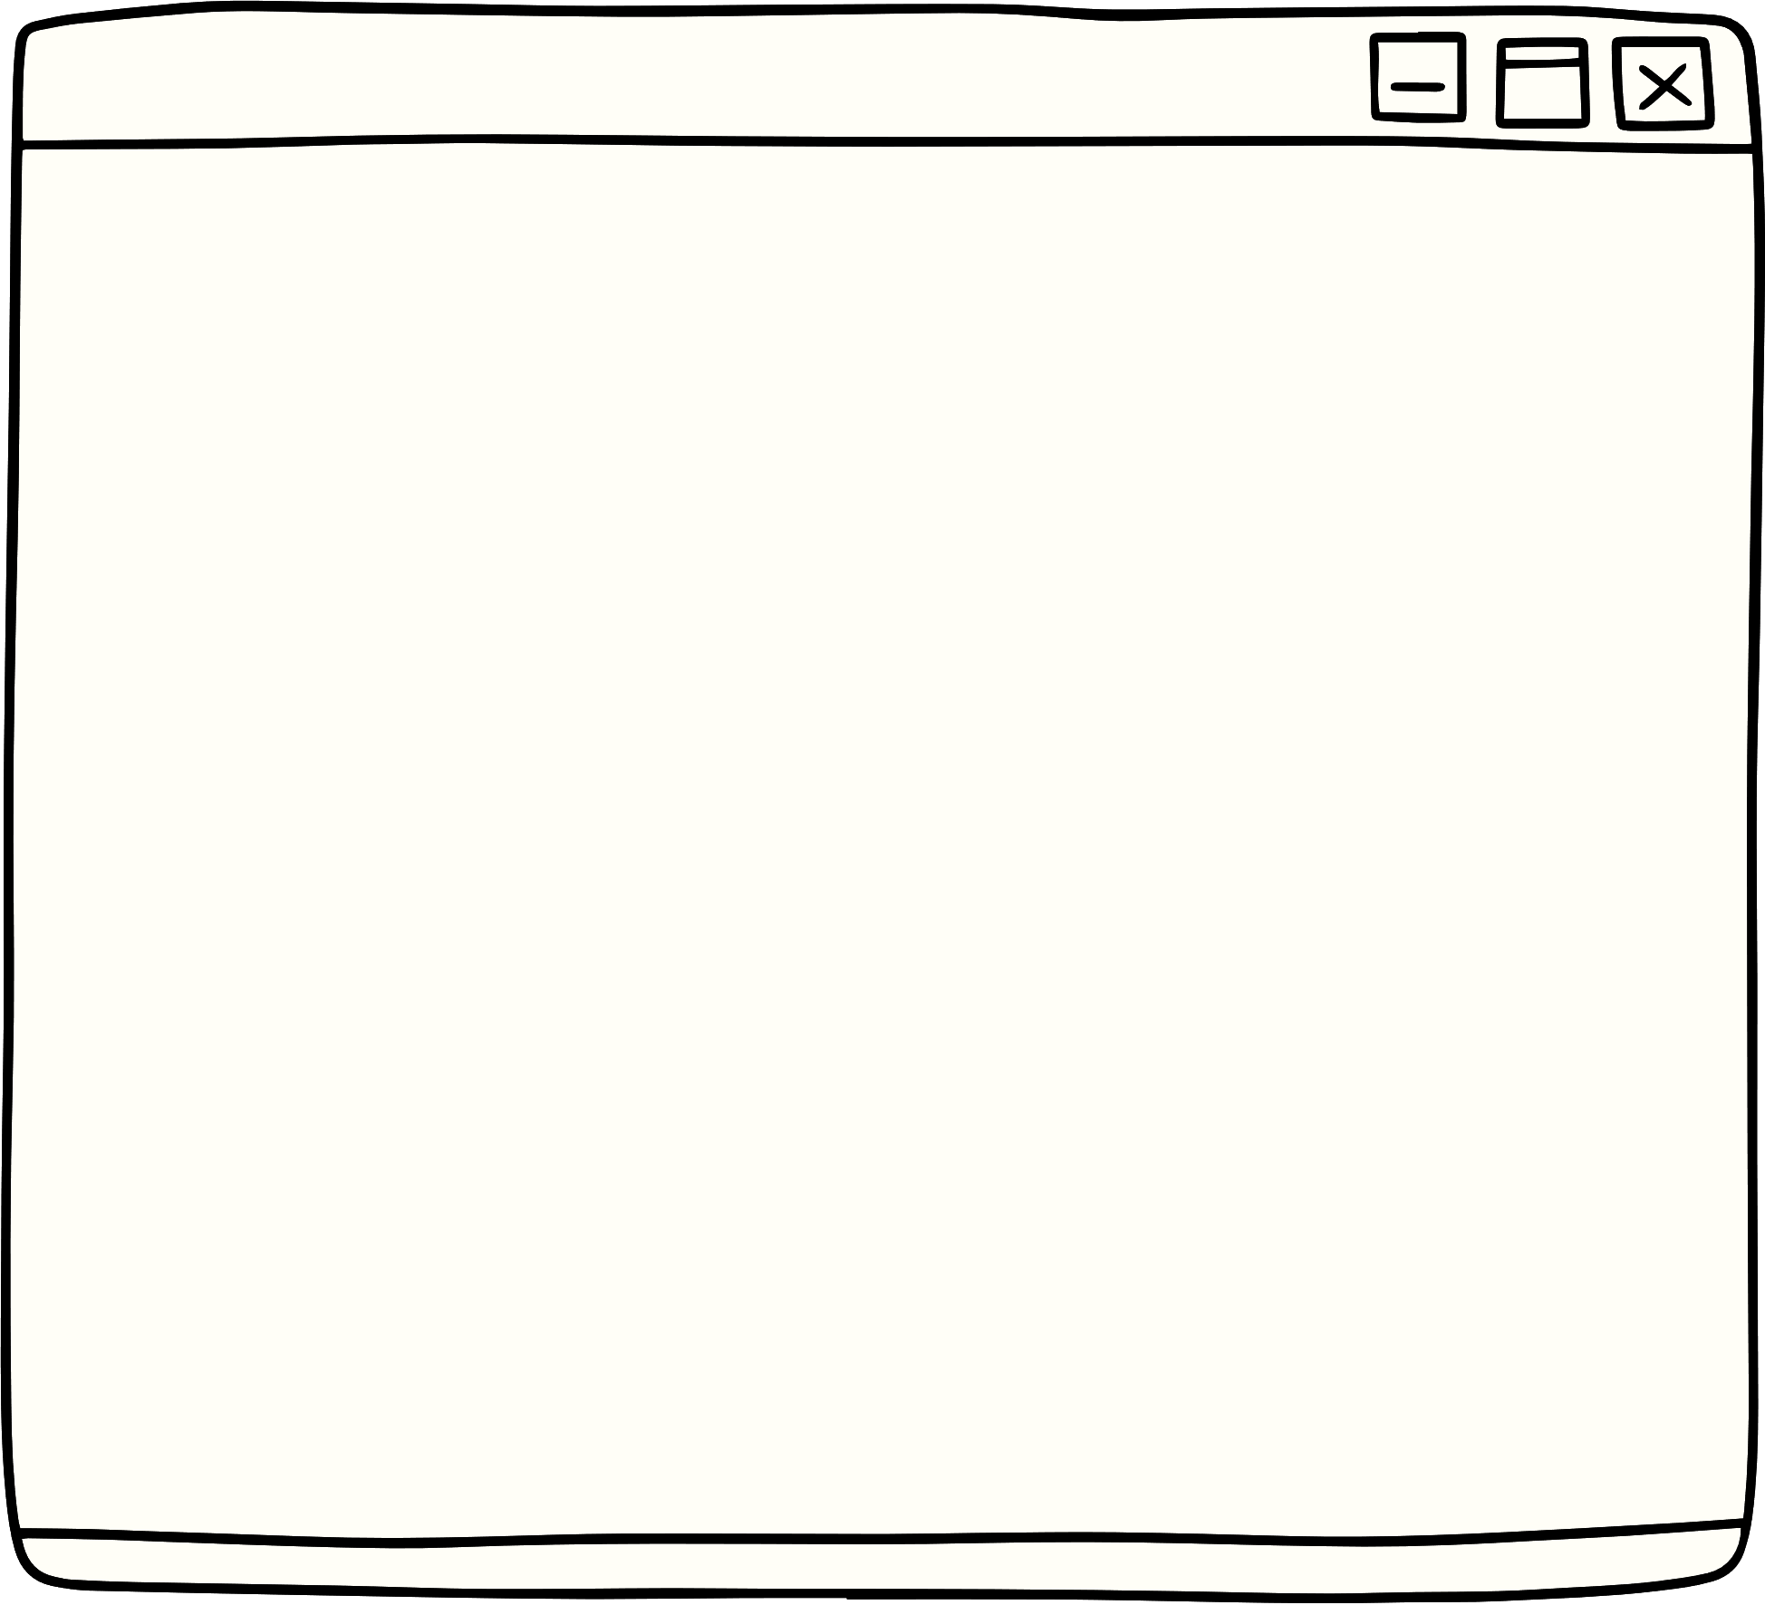
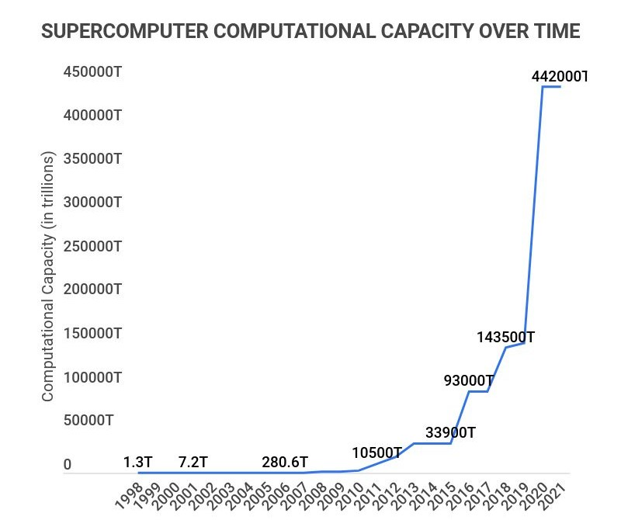

Fastest Growing Industry
Computers performance increases every 2 year, yet cost less
Old model of HP 3000 cost more than half a million in today’s dollar
Travel from LA to NY in 2 seconds
Notes:
Even Toaster today have a computer integrated in them
Computers performance increases every 2 year, yet cost less
the most basic model of an HP 3000 was sold for $95,000 in 1972, the equivalent of slightly over half a million in today’s dollars.
Today, a brand-new computer costs just a few hundred dollars and has capabilities that in 1972 were in the realm of science fiction.
And if the industry of aircrafts were growing as fast, Travel from LA to NY in 2 seconds

Slide 5






Order:
Recipe
Crispy Chicken sandwich
Fry Chicken
Griddle the buns
Assemble sandwich
Give to the Customer
Program:
Fundamental steps
Show result on the screen
Sum of 15 and 14
Find “15”
Find “14”
Add them
Notes:
The computer and the Cafeteria employee also have something that they work on. These are called data. For example, the data for the computer might be the numbers that it needs to add, while the data for making a burger might be the ingredients that it needs to prepare.
The employee can work with different kinds of data, such as fresh legumes, bread and meat. The computer, on the other hand, can only work with one kind of data: binary.

Slide 6

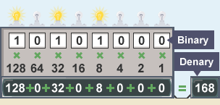
Ones and Zeros
Letters (ASCII)
Instructions
A | 01000001
a | 01100001
B | 01000010
b | 01100010
LOAD | 0001
ADD | 0010
SUBS | 0011
Notes:
String of ones and zeros
Computers use the binary number system to represent numbers, text, images, and sound with electrical signals in their circuits. The binary number system has only two symbols: 0 and 1. That’s right, computers can do amazing things with just two symbols, while humans need 26 letters, 10 digits, and countless emojis to express themselves.
Computers use different codes to translate binary data into human-readable information. For example, ASCII (American Standard Code for Information Interchange) is a code that assigns a pattern of 8 bits (called a byte) to each character, such as letters, numbers, punctuation marks, and symbols. For example, the letter A is represented by the binary code 01000001.

Slide 7
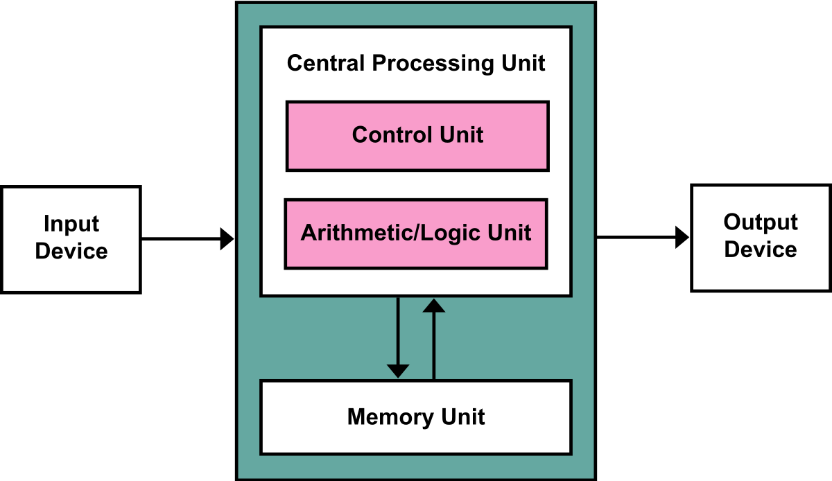
Von Neumann Architecture: Essential parts of the computer
Note: The parts of a computer communique through what they call the “bus”. The wider the bus, the more capable is the computer. My computer design has a buss that can manage 8 bits of data.
Notes:
A CPU is like the brain of a computer, except it doesn’t have any feelings, dreams, or existential crises. It just tells the computer what to do and how to do it. That’s it.
It is important to note that the parts of a computer communicate through what they call the “bus”. The bus is like a road that connects different parts of the computer.
My mission for this project was to build all those components individually from scratch, and assemble them to work together.

Slide 8
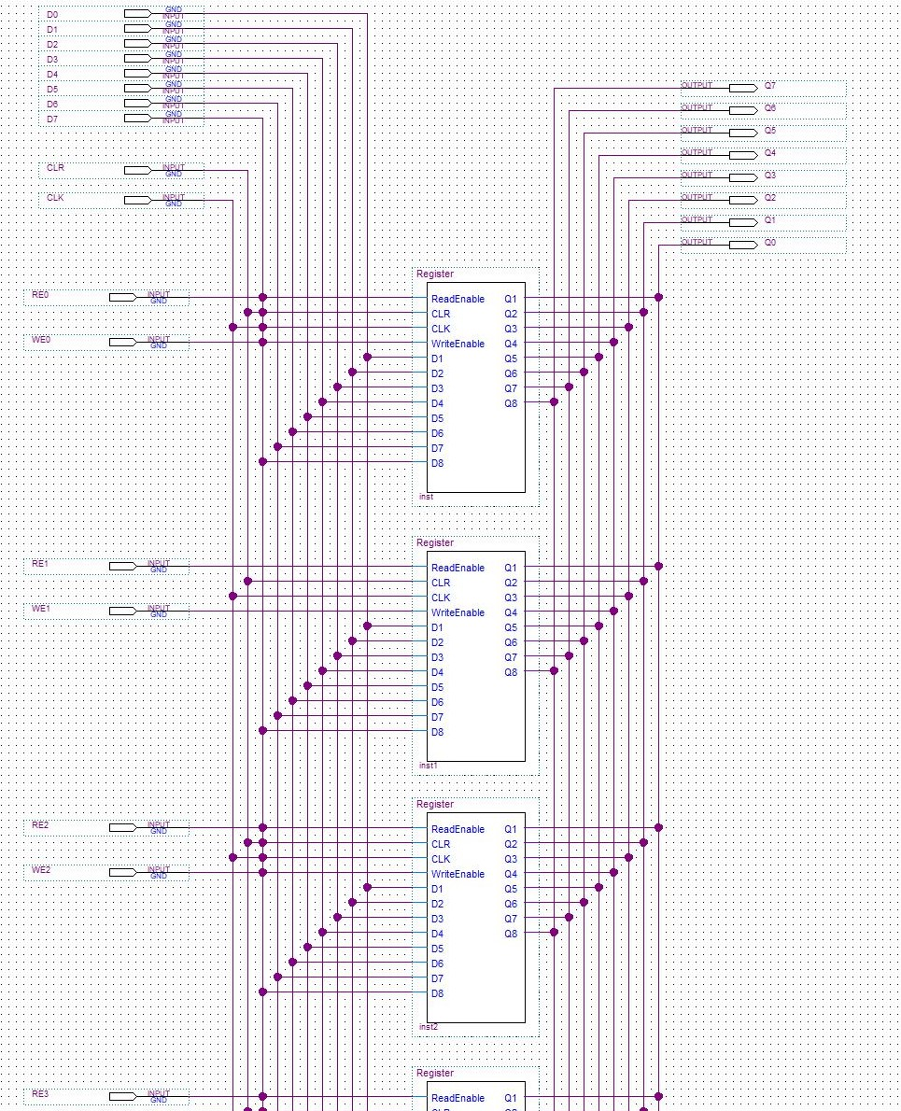
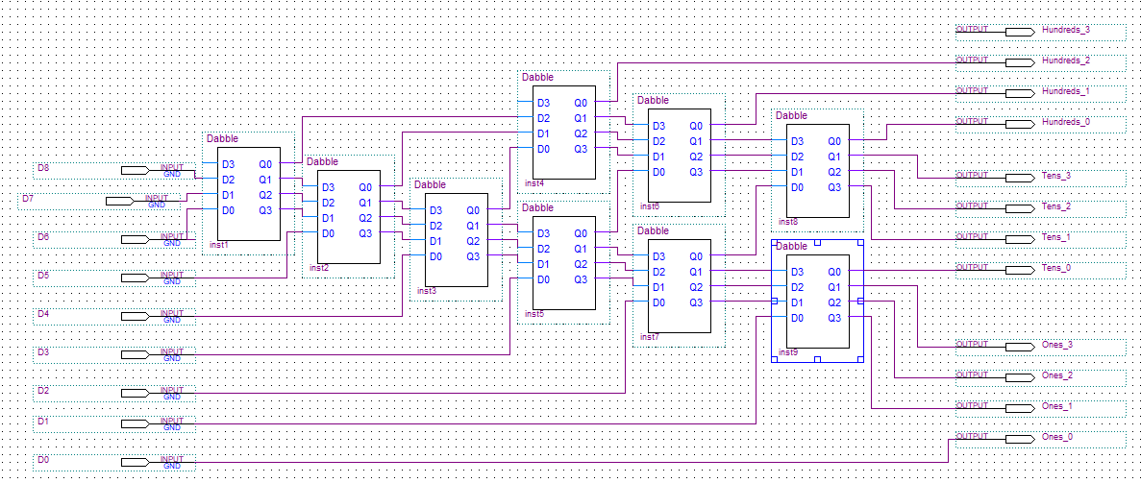
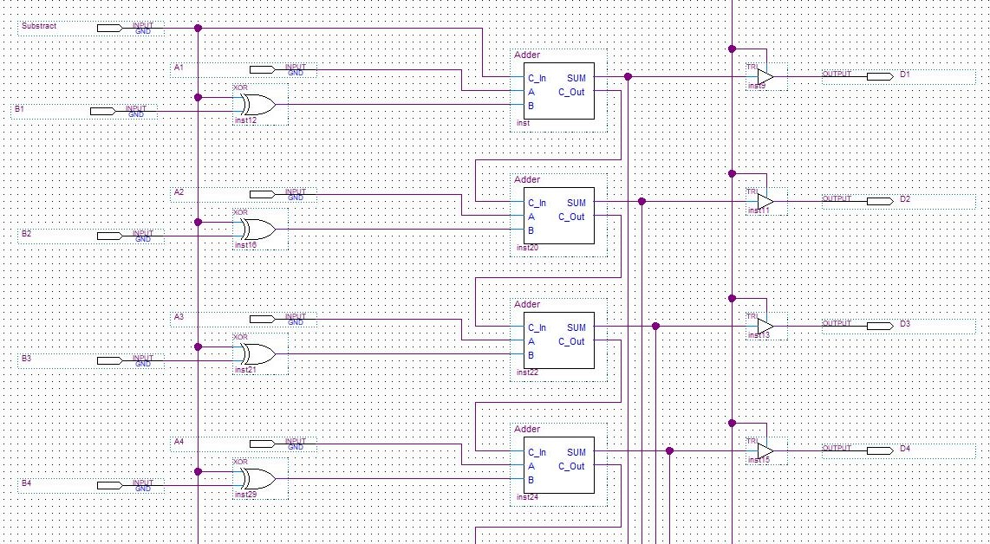
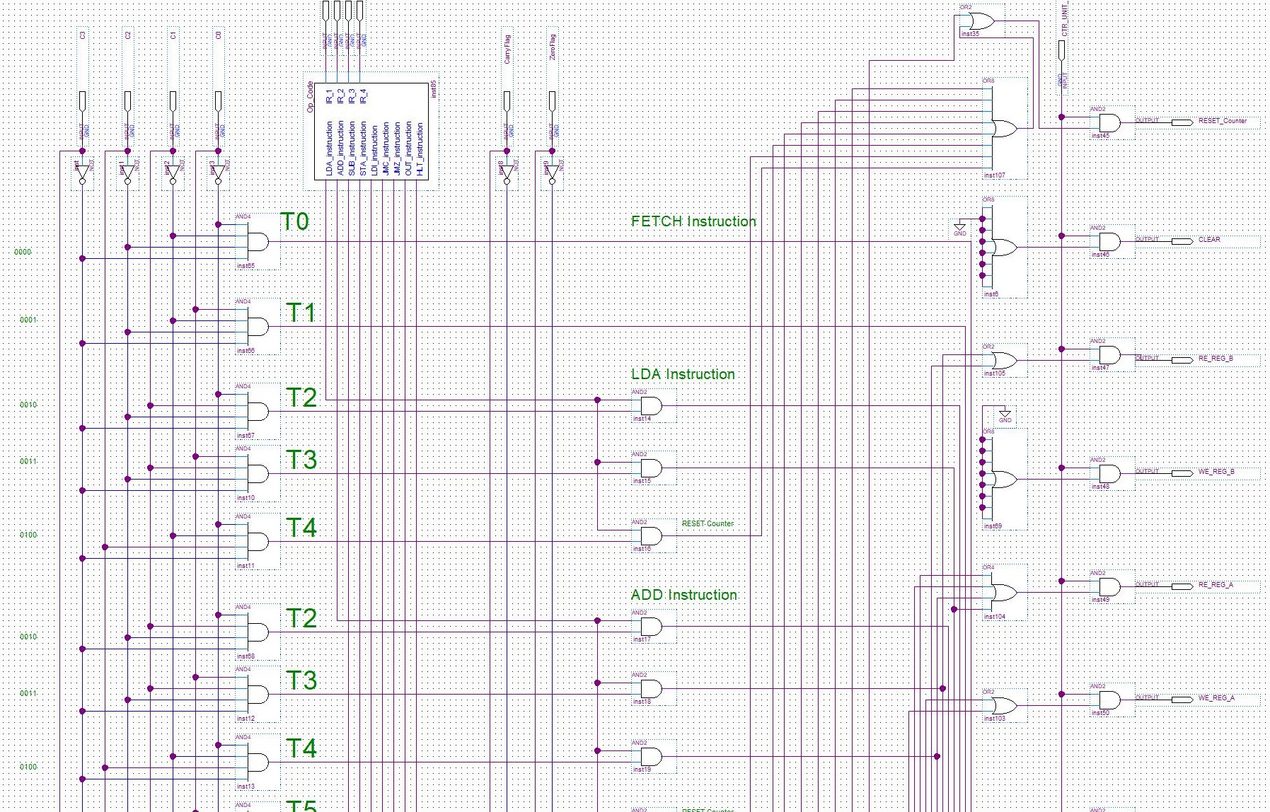
Output
Memory
ALU
Control Unit

Slide 9
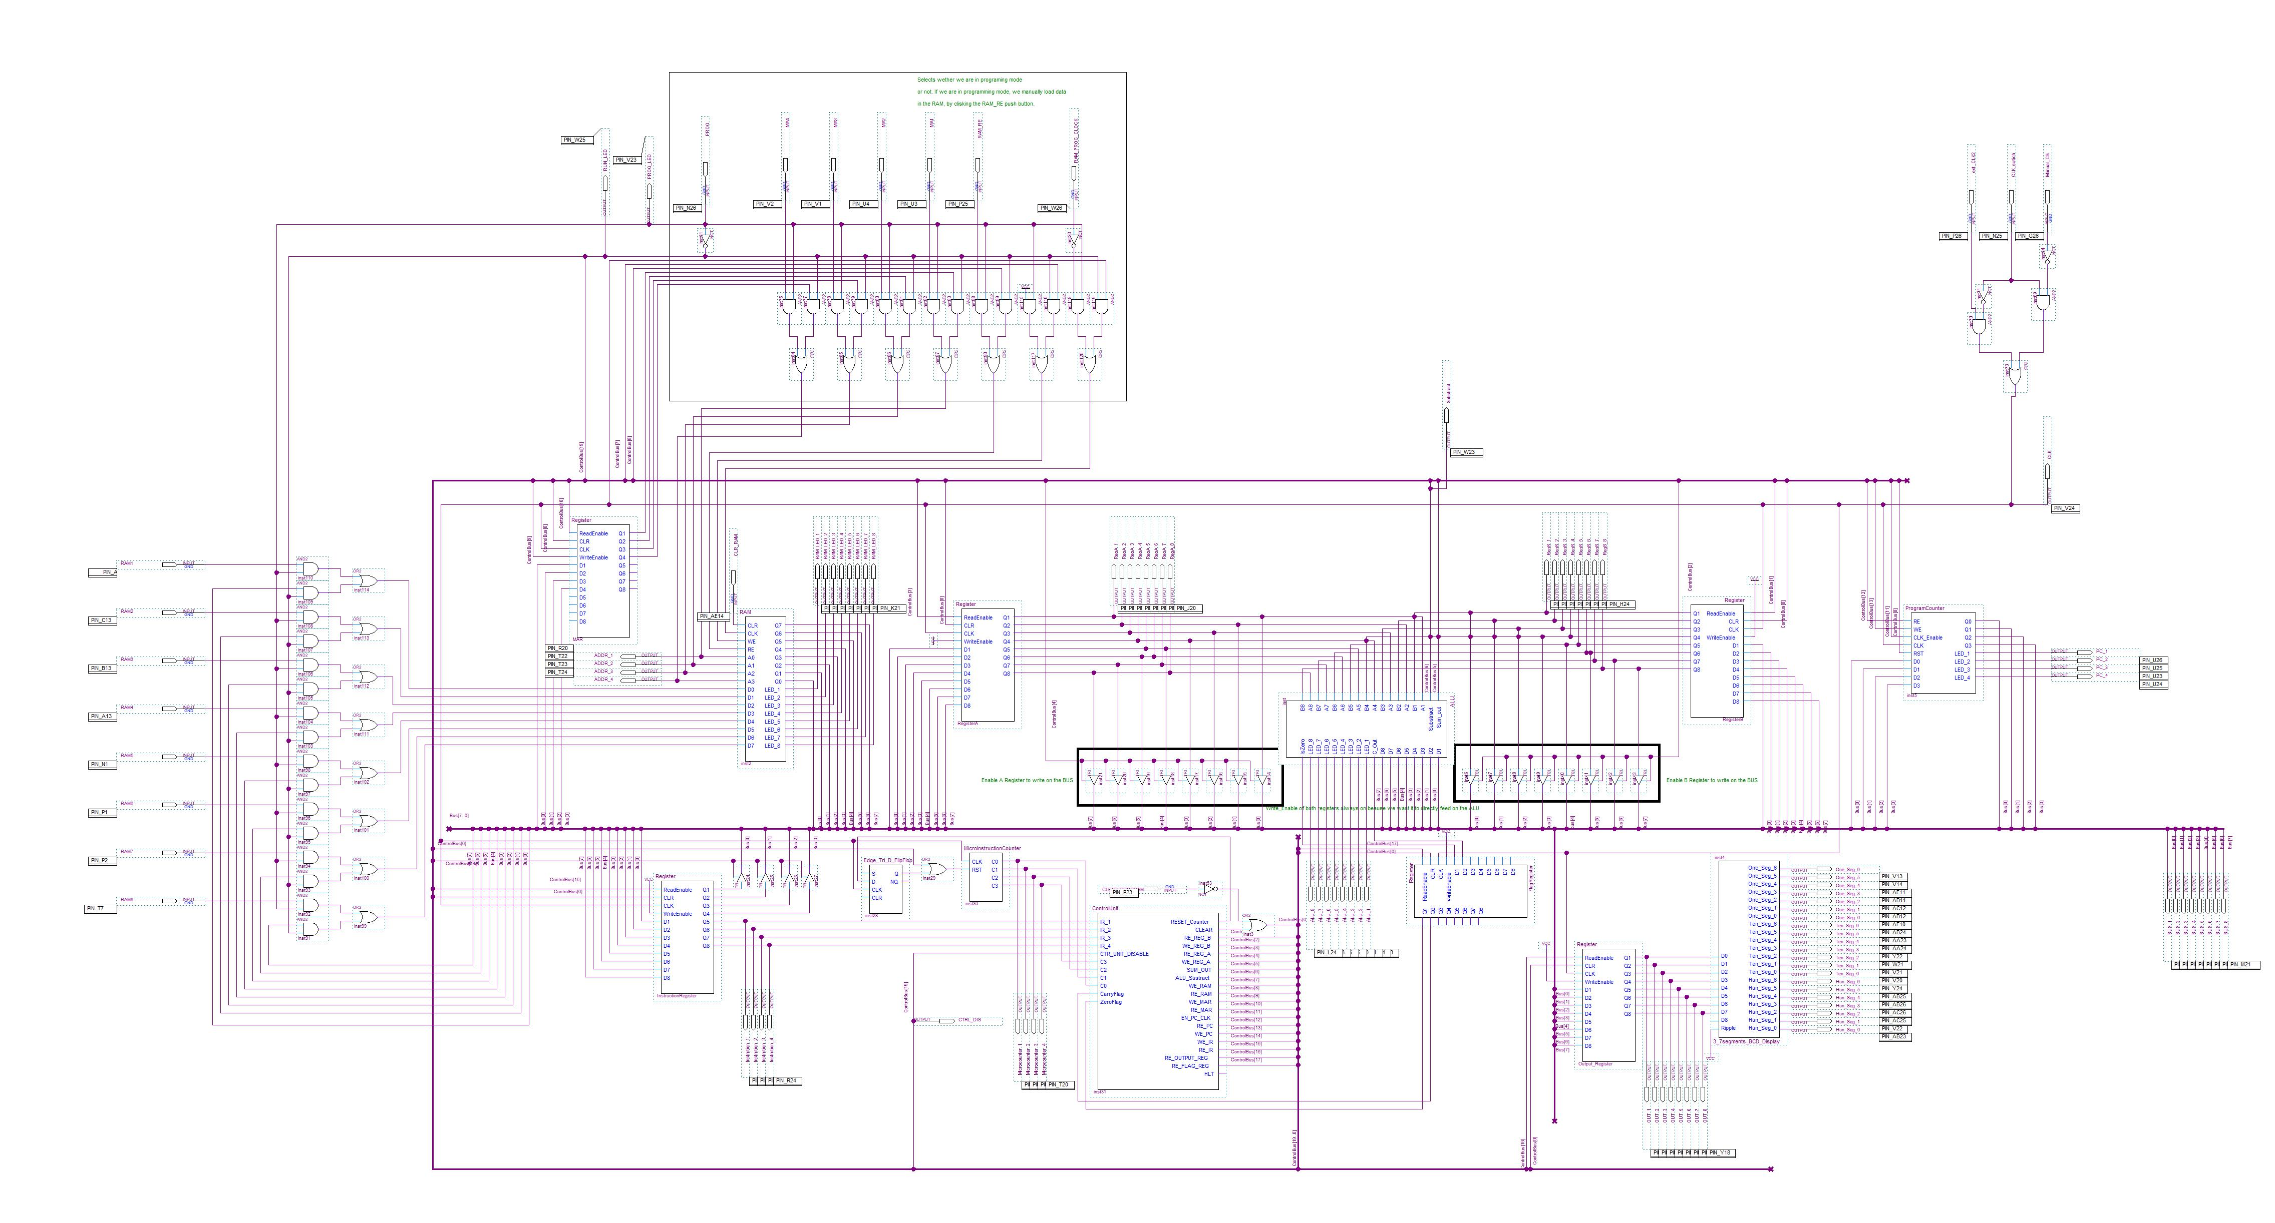
Notes:
Altera FPGA board and Quartus Software

Slide 10
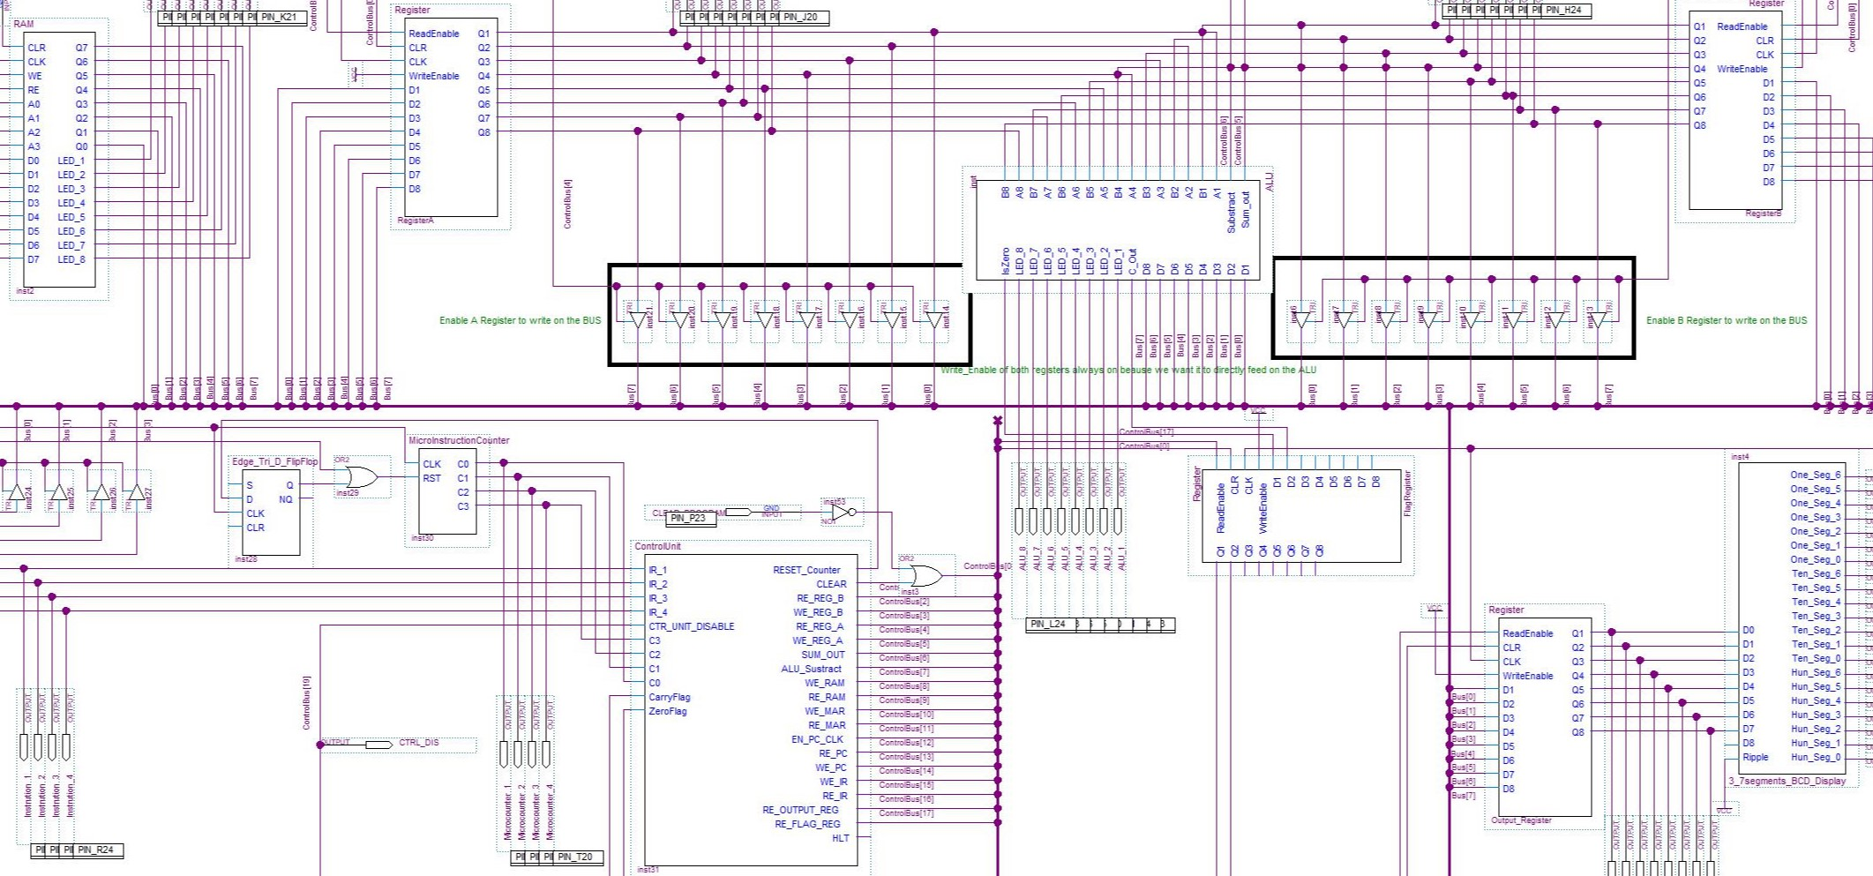
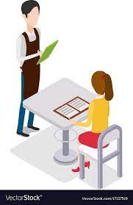



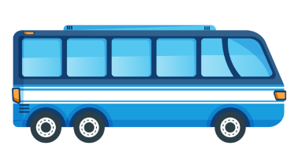


0 0 1 0 1 1 1 1
0 0 0 1 1 1 0 1
0 0 0 0 1 1 1 1
0 0 0 0 1 1 1 0
0 0 1 0 1 1 1 1
0 0 0 1 1 1 0 1
=29
Notes:
Now that we have built it, the next step is to

Slide 11
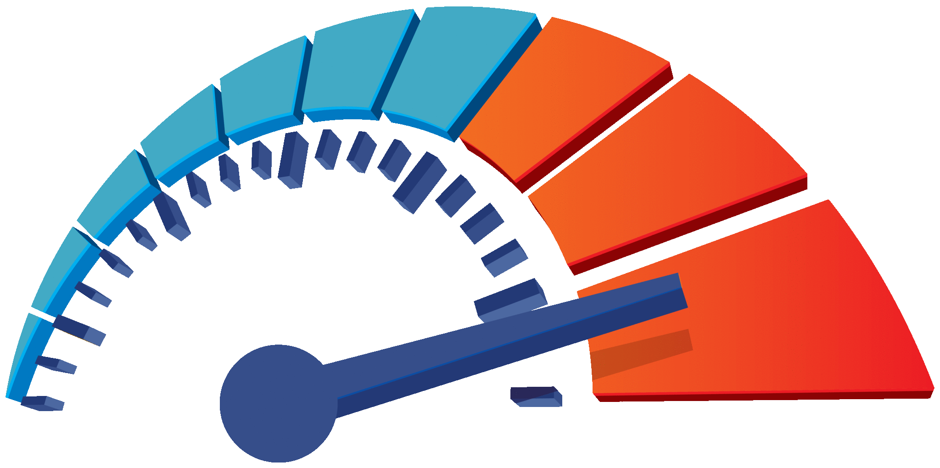
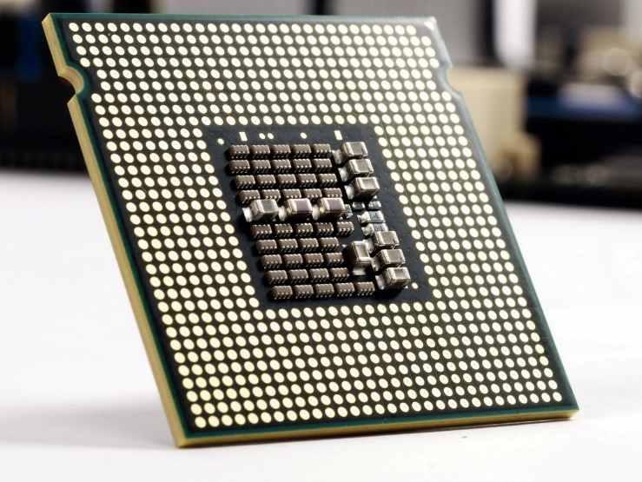
More speed
Billions of operation per second
Ability to multitask
Ability to manage larger numbers and provide more precision
Scaling up
Notes:
Every computer have an internal heartbeat that we call the clock. The faster the clock, the more the computer can do in one second. For example, modern computers have a clock that tics billion times per second. By extension, your computer can execute billions of operation per second.
Also, as I mentioned earlier, all the parts of the computer communicate through the bus. It can be compared to an highway. The wider the highway, the more traffic it can handle, and the faster the computer can run.
My computer design has a bus that can manage 8 bits of data. That means it can carry a sting of 8 0s and 1s at a time. But this is like a bicycle lane, while modern computers are like highways.
This is because modern computers can have buses that can manage 64 bits of data or more. With a wider bus, the computer can manage larger numbers and provide more precision.
Moreover, moder computer have CPUs with multiple cores, which allows multitasking.

Slide 12

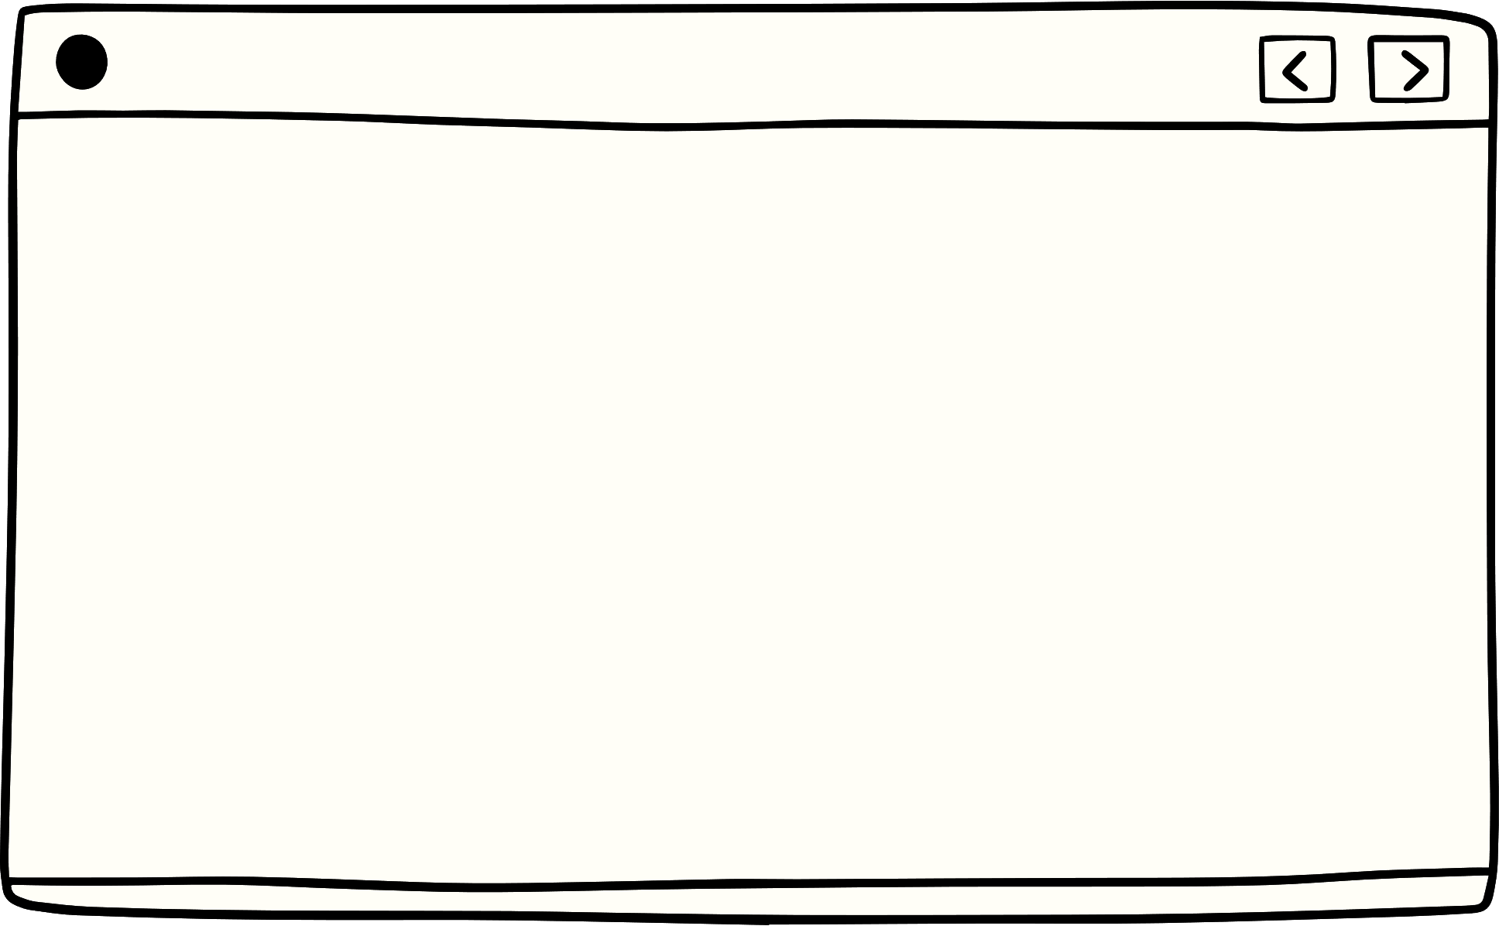

Thank you
Notes:
I hope you now have a clearer picture of what happens behind the scenes when you interact with a computer. For me, this project has an educational value. Due to each component being built from scratch, it is a good resource for students in Computer Engineering to understand what is actually happening behind the scenes. I haven’t taken any computer engineering class before, so this project is good for explaining concepts while escaping some vocabulary that might be confusing in the class.

Slide 13
Resource page
Special thanks to Jacob Eapen for his guidance
Beneater.net
eecs.blog/8-bit-computer-program-counter/

